Slide 1
Memory
PSY 101, BRAC University

Slide 2
Free Write!

Slide 3
The Fragile Power of Memory
Notes:
So let's talk about memory today and the fragile power of memory. If memory didn't
work, we wouldn't remember anything. We wouldn't learn anything. So we know it
has to work reasonably.
But it has a number of fragile aspects we'll talk about where, of course, we forget
things. But on top of that, it turns out there's ways in which our memories get less
accurate and distorted, are not actual records of our experience but rather
interpretations or our memory of our memory

Slide 4
Remembering and forgetting
Why do we remember what we experience?
Why do we forget what we experience?

Slide 5
Bottom-Up and Top-Down Influences on Memory
Bottom-Up
perceptual experience what we see and hear
Top-Down
prior knowledge, concepts, expectations, subsequent experience and which grows over time
Notes:
Bottom-up memory might be really
the video camera if we had it, an actual recording of what we hear, what we see,
what we experience out there in the world. Top-down processes are the mental
things we have in our minds that let us interpret what's out there, concepts,
expectations. Also, it turns out, you'll see that subsequent experiences go back and
change memories from prior times. And which of these things, the bottom-up
original experience, or the top-down interpretation grows over time to constitute
your memory?

Slide 6



The Three-Stage Model of Memory
Sensory Memory
Short-Term Memory
Long-Term Memory
Rehearsal
Image by MIT OpenCourseWare.
Notes:
So we can have a very simple model of memory, a flash for a moment. I'll give you
an example of how people test this, a sensory memory, very tiny moments only.
Short-term memory that you can rehearse in some cases. Somebody tells you a
number, And you can repeat it over and over again. You have that capacity. And
then long-term memory, things that last for a long time.
When we talk about the brain organization of human memory, we'll say that shortterm
memory is probably, lasts seconds. And everything after that is long-term
memory. Now, of course, if you just experienced something, you'd remember it
better. If it's a week, a month, a year, five years from now, most likely less better. So
time passes. But we think almost all of that is in the context of long-term memory
capacities of your mind.

Slide 7
Test of Digit Span
Span of 4: 6 1 9 4
Span of 5: 3 7 8 5 2
Span of 6: 9 6 5 2 8 3
Span of 7: 4 2 6 9 8 5 1
Span of 8: 8 1 6 3 7 2 4 9
Span of 9: 6 2 5 7 3 4 9 8 1
Span of 10: 9 3 8 2 4 7 1 5 3 6
Span of 11: 5 8 1 4 7 9 3 2 6 1 7
Notes:
INSTRUCTORS:
ASK A VOLUNTEER TO CLOSE THEIR EYES. READ EACH BULLET POINT AND HAVE THEM REPEAT THE NUMBERS BACK TO YOU. THEY WILL NOT BE ABLE TO GET PAST 8 OR 9. THAT IS THE LIMIT OF HUMAN SHORT TERM MEMORY.

Slide 8
Short-term memory
Limited Capacity
7 +/- 2 chunks
Prior knowledge defines chunks, allows for more information to be retained in memory, may also miscode information
Notes:
There used to be some confusions about this. Because they would say kids in
different countries have different limits. And they'd say our country is smarter than
your country, or our educational system is better than your educational system. It
turned out that all of that got equated around the world if you counted up the
number of syllables that are in the digits. The real unit of memory here are syllables.
So in English, most of the numbers are one syllable. 1, 2, 3, 4, 5, 6 are all one
syllable. 7 gets two. 8 is one syllable. 9 is one syllable.
In some other languages, the words that go with the digits are two syllables. So
countries that have two syllables, they have lower spans not because they were
dumber or had a worse education system. It's because the real unit is number of
syllables. Because you're hearing it. It's language. So around the world, it's the
fundamental capacity of the human mind is that you're limited to these kinds of stuff.

Slide 9
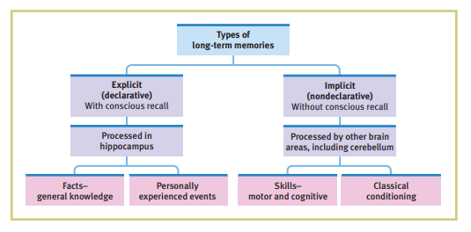
Long Term Memory

Slide 10
What letters do you see?
G D C E I A H B F
Notes:
And people use the word "chunking" as the way in which you use your background
knowledge to get big pieces of information stored that are better than you think for
short-term memory limits. So here's a quick one. I need a volunteer.
SHOW CLASS THIS AND THEN MOVE TO NEXT BLANK SLIDE, ASK THEM TO REMEMBER

Slide 12
What letters do you see?
A B C D E F G H I
Notes:
SHOW CLASS THIS AND THEN MOVE TO NEXT BLANK SLIDE, ASK THEM TO REMEMBER

Slide 13
Notes:
The same letters, it's just that now you see the chunks. And you can map them onto background knowledge. Much much easier to remember!

Slide 14
WHAT WORDS DO YOU SEE
LEAF PAPER SEAT TIRE CAR FISH ROCK WIRE WHEEL BEACH TREE BOY RADIO RULE

Slide 16
WHILE I WAS WALKING THROUGH THE WOODS A RABBIT RAN ACROSS MY PATH
Notes:
you can use your background knowledge of what does a sentence mean? What's
the ergative syntax? All your background knowledge can be applied. Again, the
power of background knowledge is immense.
I can tell you that if you go work somewhere, or if you're working in a lab now, or if
you're working in any place, you might be impressed by people who are older than
you, and what they know, and what they can learn and pick up. It's background
knowledge, background knowledge, background knowledge. It lets you quickly
understand an idea, because you can interpret it from prior ideas that you know,
quickly read a paper, because you can slot it into prior things you know. Background
knowledge is incredibly powerful to let you discover the signal and get a lot of the
specific information in any kind of information out there.

Slide 17
Mailbox
Sardine
Shotgun
Peacock
Credit
Detail
Flicker
Airline
Spinach
Clarinet
Notes:
All right. So think about this for a moment. We said seven plus or minus two. When
the words are presented in a random, unorganized list like this, you're pretty much
back to short-term memory limits in many senses, not completely, but in many
ways.
So if you were to tell a person on the street, I mean, I have to say two things about
you guys, which is certainly true and complimentary. Most of you, if you're
somewhere between 18 and 25, you're at your peak memory capacity for the rest of
your life. You will never do better for rote learning then you are right now. There's a
ton of research that shows that. You will never do better for rote learning than about
18 to 25. After. that it's downhill.
You get other benefits. Salaries go up a little bit. You get authority. That's a nice
one. But rote memory, you're at the top.
You're incredibly selected to be the
top of the top, in many senses, for learning between. You are our hope for the future. If you guys can't fix global
warming, we're in trouble. So you can't get 10 words? Come on. We have big problems to solve. It's a capacity
of the human mind that we just can't do about more than this. It's just amazing how
limited rote memory is without other things.
But there's a little bit more than we can tell. How many of you got mailbox and
sardine? A fair number of hands. OK. How many of you got spinach and clarinet, the last two words? How many of you
got credit and detail? Way fewer hands. And that's what happens under a wellcontrolled
experiment

Slide 18
A few more things about memory…
Primacy and recency
Deep vs shallow encoding
Context matters!
Organization

Slide 19
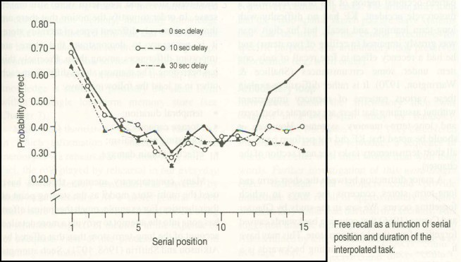
Primacy Effect = LTM Recency Effect = STM
Courtesy of Elsevier, Inc., http://www.sciencedirect.com. Used with permission. Source: Glanzer, M., and A. R. Cunitz. "Two Storage Mechanisms in Free Recall." Journal of Verbal Learning and Verbal Behavior 5, no. 4 (1966): 351-60.
Notes:
So this is correct. High is correct. This is what order the word was in the first word
you heard, say the fifth. This experiment is 15 words. You can see that. Here's their
performance.
Two things are noteworthy. People do best for the first couple of words. And
sometimes they did best for the last couple of words.
So here's three delays. These delays are zero seconds what we did. You get the
list, you immediately write them down and recall them verbally. That's zero,
immediate. Or I wait 10 seconds and then say, now recall. Or I wait 1/2 minute and
say, now recall.
Now memory for the first two items is what's called a primacy effect. It doesn't
matter. In all three conditions, those are the best two remembered words, on
average, for most of the experiment.
And people think that's a signature of long-term memory. You can get those one or
two words. And then you start to get overwhelmed in long-term memory. Here, you
only get the boost for the last couple of words if there's zero second delay. If there's
10 seconds or 30 seconds delay, no boost.

Slide 20
Ebbinghaus’ Curve of Forgetting
100
90
80
70
60
50
40
30
Immediate recall
Percentage of words remembered
20 minutes
1 hour
9 hours
20
10
0
1 2
6
31
Days since learning
Image by MIT OpenCourseWare.
Notes:
Now Ebbinghaus is one of the founders of experimental studies of memory. And he
was heroic. He would just train himself. He would use nonsense syllables, because
he wanted to get rid of a lot of background stuff, rote memory.
And he would learn thousands of these and then test himself and score himself
10
honestly. He did the bulk of the work on himself. And he discovered something
that's pretty simple, but that has had a huge effect.
So how well do you do s.ince you learned something all in long-term memory if
you're tested immediately? 100% if it's small list and you studied a lot. 20 minutes
later, an hour later, nine hours later, you can see the steep forgetting up until about
10 hours. And then it sort of hangs in there

Slide 21
If word is in CAPITAL LETTERS, Tap left hand
If word is in lowercase letters, Tap right hand

Slide 22
zebra CAR TABLE
mosquito MONKEY
train DESK
termite
BUS
wasp camel SOFA
zebra CAR TABLE
mosquito MONKEY
train DESK
termite
BUS
wasp camel SOFA

Slide 23
WHAT WERE THE WORDS?

Slide 24
If word names a LIVING thing, Tap left hand
If word names a non-living thing, Tap right hand

Slide 25
SPIDER
chair FOX TRUCK
lamp BEE
tiger
boat RABBIT
tractor bed
BUTTERFLY
SPIDER
chair FOX TRUCK
lamp BEE
tiger
boat RABBIT
tractor bed
BUTTERFLY

Slide 26
WHAT WERE THE WORDS?

Slide 27
zebra CAR TABLE
mosquito MONKEY
train DESK
termite BUS
wasp camel SOFA
SPIDER
chair FOX TRUCK
lamp BEE
tiger boat RABBIT
tractor bed
BUTTERFLY
Appearance Shallow Encoding
Poor Memory
Meaning
Deep Encoding Good Memory
Notes:
PEOPLE HAVE A MUCH EASIER TIME REMEMBERING WORDS THE SECOND TIME BECAUSE YOU ARE ENCODING THE MEANING – A DEEPER ENGAGEMENT WITH IT

Slide 28
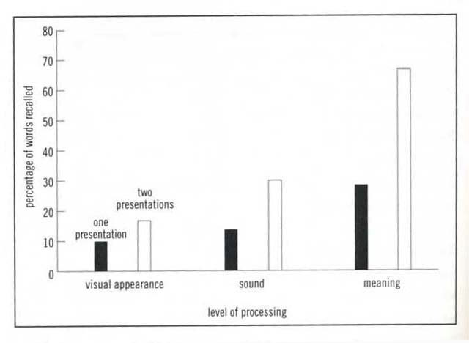
Courtesy of Elsevier, Inc., http://www.sciencedirect.com. Used with permission. Source: Craik, F. I. M., and R. S. Lockhart. "Levels of Processing: A Framework for Memory Research." Journal of Verbal Learning and Verbal Behavior 11, no. 6 (1972): 671-84.

Slide 29
SERVE
EDUCATE
LAWYER
CAREER DUST PHYSICIAN SKILLED
VACUUM DESIGNED HOME
WRITER SCRUB PLUMBER
ELECTRICIAN HOUSEWORK ARTIST BATHE
TEACHER CARPENTER RESPONSIBILITIES FOOD
COOK ENTERTAIN CHILD CARE PROFESSIONAL
PURCHASE CREATIVE

Slide 30
RESPONSIBILITIES
CAREER
HOME
PROFESSIONAL LAWYER PHYSICIAN TEACHER
SKILLED PLUMBER ELECTRICIAN CARPENTER
CREATIVE WRITER ARTIST DESIGNER
HOUSEWORK VACUUM DUST
SCRUB
CHILD CARE BATHE EDUCATE ENTERTAIN
FOOD PURCHASE COOK SERVE
Memory better after semantically organized display than after random display

Slide 31
What do you do to remember
better when studying?
Notes:
ASK STUDENTS TO SHARE SOME OF THEIR OWN TIPS FOR REMEMBERING – ALL OF WHICH PROBABLY FALL INTO SOME OF THE CATEGORIES WE ARE DISCUSSING

Slide 32
WHY DO WE FORGET?
passive forgetting? or
interference?
Notes:
One of them is like passive.
Well, I haven't used it in a while. It's just not available anymore. Because time has
passed. It's not been used. It's not available. That's passive forgetting
The other way to think about why we forget is not that it's a passive loss of
knowledge. But that experiences you have after that moment when you learned
something, will go back and write over, and muddy, and confuse your memory for
the original event. It's active interference of subsequent experience.

Slide 33
Interference
Proactive interference
Occurs when you cannot learn a new task because of an old task that had been learnt.
Retroactive interference
Occurs when you forget a previously learnt task due to the learning of a new task.
Notes:
And people have talked about it in two different directions that you can think about
this. One of them is what you call proactive interference where things from before
mess up your learning on something. Or retroactive interference, you already have
the memory. And now new things mess you up and write over the memory. So
memory is threatened by what came before they experience or what happens after
the experience In the way that it interferes with accuracy of memory

Slide 34
FLASHBULB MEMORIES
Emotion important in determining what we remember - surprise & arousal
place
ongoing activity source of news own feelings emotions in others aftermath
Studies that test right after and a year later:
better remembered, but susceptible to distortion
over-confident

Slide 35
Loftus study
Planting lost-at-mall memories
Jim, graduate student, “reminds” younger brother Chris of losing Chris in a mall when Chris was five, and an older, tallish man bringing him back.
Two days later, Chris says, “I was with you guys for a second and I think I went over to look at the toy store, the Kay-bee toy, and, uh, we got lost and I was looking around, and I thought, ‘uh-oh. I’m in trouble now.’ You know. And then I…I thought I was never going to see my family again. I was really scared, you know. And then this old man, I think he was wearing a blue flannel, came up to me…he was kind of old. He was kind of bald on top…he had a ring of grey hair…and he had glasses.”
Notes:
So they did this experiment. Jim, a graduate student, reminded his younger
brother Chris that they lost Chris in a mall when Chris was five, and an older tallish
man brought him back.
So that would be a pretty traumatic thing for a five-year-old to be lost in a mall and
have an old man take you back. Certainly for the parents, you're going where's the
kid? Where's the kid?
So two days later, Chris says, the younger kid, yeah. I was with you guys for a
second. And then I went over to look at the toy store, the KB Toys. And then we got
lost. And I was looking around. I thought, I'm in trouble now.
And then I thought it was never going to see my family again. I was really scared.
And this old man, I think he was wearing a blue flannel, came up to me. He was kind
of old. He was kind of bald.
Chris was never lost. Jim, the graduate student, being mean to his younger brother,
but for good science reasons, told him this slight story. He didn't give him any of
these details. He just said remember when you were five years old and got lost in
the mall, and the old tall man brought you back?
But what's happening is our memories of when we're kids are pretty vague. Chris is
sort of mixing in some real things that happened in the story. And he's fabricating.
He's not trying to get away with anything. He's just creating this false memory.

Slide 36
dark October night
woman hitchhiker picked up on Pacific Highway South 10 miles outside of Seattle
man turns into isolated dirt road, rapes her, leaves her by the side of the road
24 hours later she looks at array of photos, picks Steven Titus - he is convicted
few months later, another man is arrested for a series of rapes - she sees picture and realizes this is the real rapist
Titus released - lost all his money, job, fiancee, reputation - 4 years pursuing a lawsuit - dies 11 days prior to trial of a heart attack - 10 months later his estate gets $2.8M
80,000 trials/year rely mainly on eyewitness testimony - of 1,000 wrong convictions, about half involved eyewitness errors
Notes:
In a dark, October night, a man picks up on Pacific Highway, south of Seattle,
hitchhiker. It turns into an isolated road. The man brutally rapes her and leaves her
by the side of the road. 24 hours later, she looks at an array of photos, and she
picks out a man who was convicted. Because she says, that's the man who brutally
raped me.
A few months later, another man was arrested for a series of rapes. She sees his
picture in the newspaper, and she realizes oops. Sadly, this is the man who
attacked and raped me.
He's released from jail. By then, he's lost his money, his job, his fiance, his
26
reputation. He spends four years pursuing a lawsuit. He dies 11 days prior to the10 months later, his estate gets $2.8 million because the police weren't very
careful how they did the photo lineup.
It turns out if you look at the photo lineup, his was a slightly outlier picture of the six
pictures. So the woman went for that guy. So when she's accusing him in court,
she's not trying to lie. what's she mixing up? Her memory for the photo array versus
for memory for the original event.

Slide 37
Improving Memory
How can an understanding of memory contribute to more effective study techniques?
Memory research–based strategies include studying repeatedly, making material personally meaningful, activating retrieval cues, using mnemonic devices, minimizing interference, getting adequate sleep, and self-testing.

